Slide 1
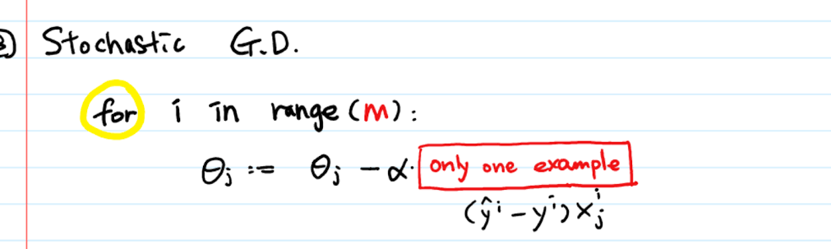
Stochastic Gradient Descent
Vidhya Dessai
Email:Vidhya.dessai@rediffmail.com
Vidhya.dessai0@gmail.com

Slide 2
What is SGD?
SGD is essentially an optimization algorithm
SGD algorithm starts at a random point, updates the cost function with each iteration using one data point at a time and builds a model with progressively higher accuracy given a large data set.

Slide 3
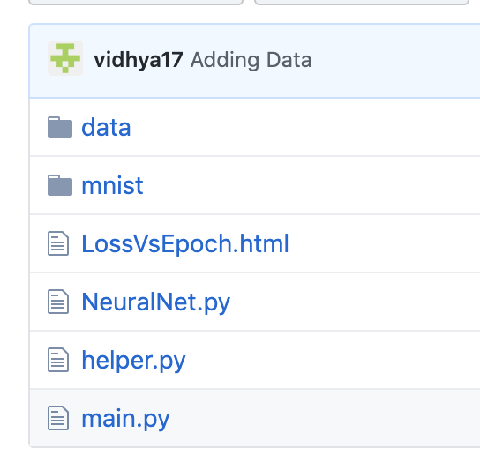
Details about Implementation https://github.com/vidhya17/SGDCCEProject
Below are the list of files which are part of Code Repository
“data” directory contains
Uses MNIST Database of Handwritten Digits
train-images-idx3-ubyte.gz: training set images (60000 ,28x28) train-labels-idx1-ubyte.gz: training set labels (60000) t10k-images-idx3-ubyte.gz: test set images (10000, 28x28) t10k-labels-idx1-ubyte.gz: test set labels (10000)
“mnist” contains logic to download mnist database (picked from online sources)
‘NeuralNet.py” – contains NeuralNet class that contains logic for building,
training and testing Neural Network.
(FeedForward ->Backpropagation(using SGD))
“helper.py” – contains implementation for Helper functions like Relu,
crossentropy,L2 Regularization, softmax etc.
“main.py” – Entry point that initializes and Invokes the Neural Network

Slide 4
Details about Implementation - Continued
Steps in Code:
Loads MNIST Dataset (details mentioned in previous slide)
Normalized intensity values of images by dividing by 255
Initializes NeuralNetwork with below parameters
no_of_nodes_in_input_layer = 784 ie. 28x28
No_of_nodes_in_hidden_layer = 20 (single hidden layer)
No of nodes in output layer = 10
batch_size = 1,
epochs = 5,
learning_rate = 0.001
Trains the network using training images (60000)
Tests the network using test data (10000)
Plot the Epoch vs Loss graph

Slide 5
Details about Implementation - Continued
# forward pass (Refer Code in NeuralNet.py for more details
z1 = input * weight_inputTohidden + bias_ToHidden
a1 = relu(z1) #Activation Function
z2 = a1 * self.weight_hiddenToOutput + bias_ToOutput
y = softmax(z2)
#Calculate Loss
#Compute Delta
#Backpropagation (SGD)
Compute Gradient
Update Weights
Note: Above steps are repeated for 5 epochs and all inputs

Slide 6
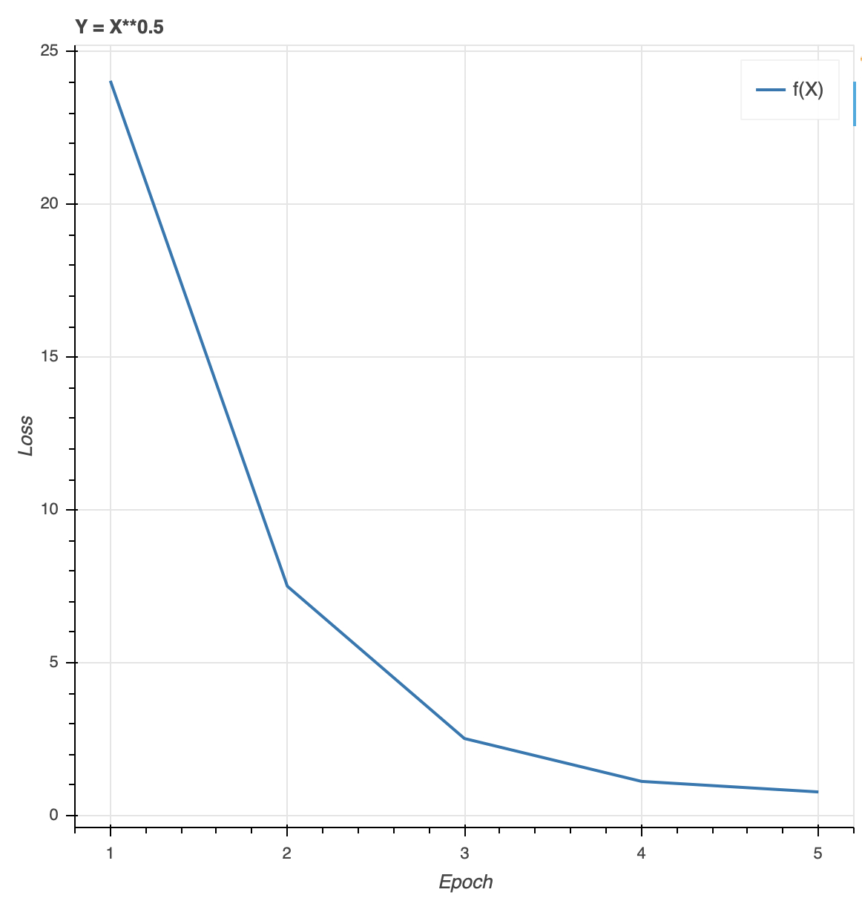
Epoch vs Loss Plot

